Slide 1
Joyride
Group #4 - Annika, Drew, John & Terrell

Slide 2

Joyride
What if you had an app that could predict the weather on a road trip?

Slide 3
Joyride - the app that gets you where you want to go, and keeps you dry!
Joyride
Whether you want to ride your bike through the park, take your motorcycle to work, or take a leisurely drive with the top down — Joyride will be there for you!
Many apps can take you there, but can they predict what the weather be like along the way?
Joyride can! (we hope)

Slide 4
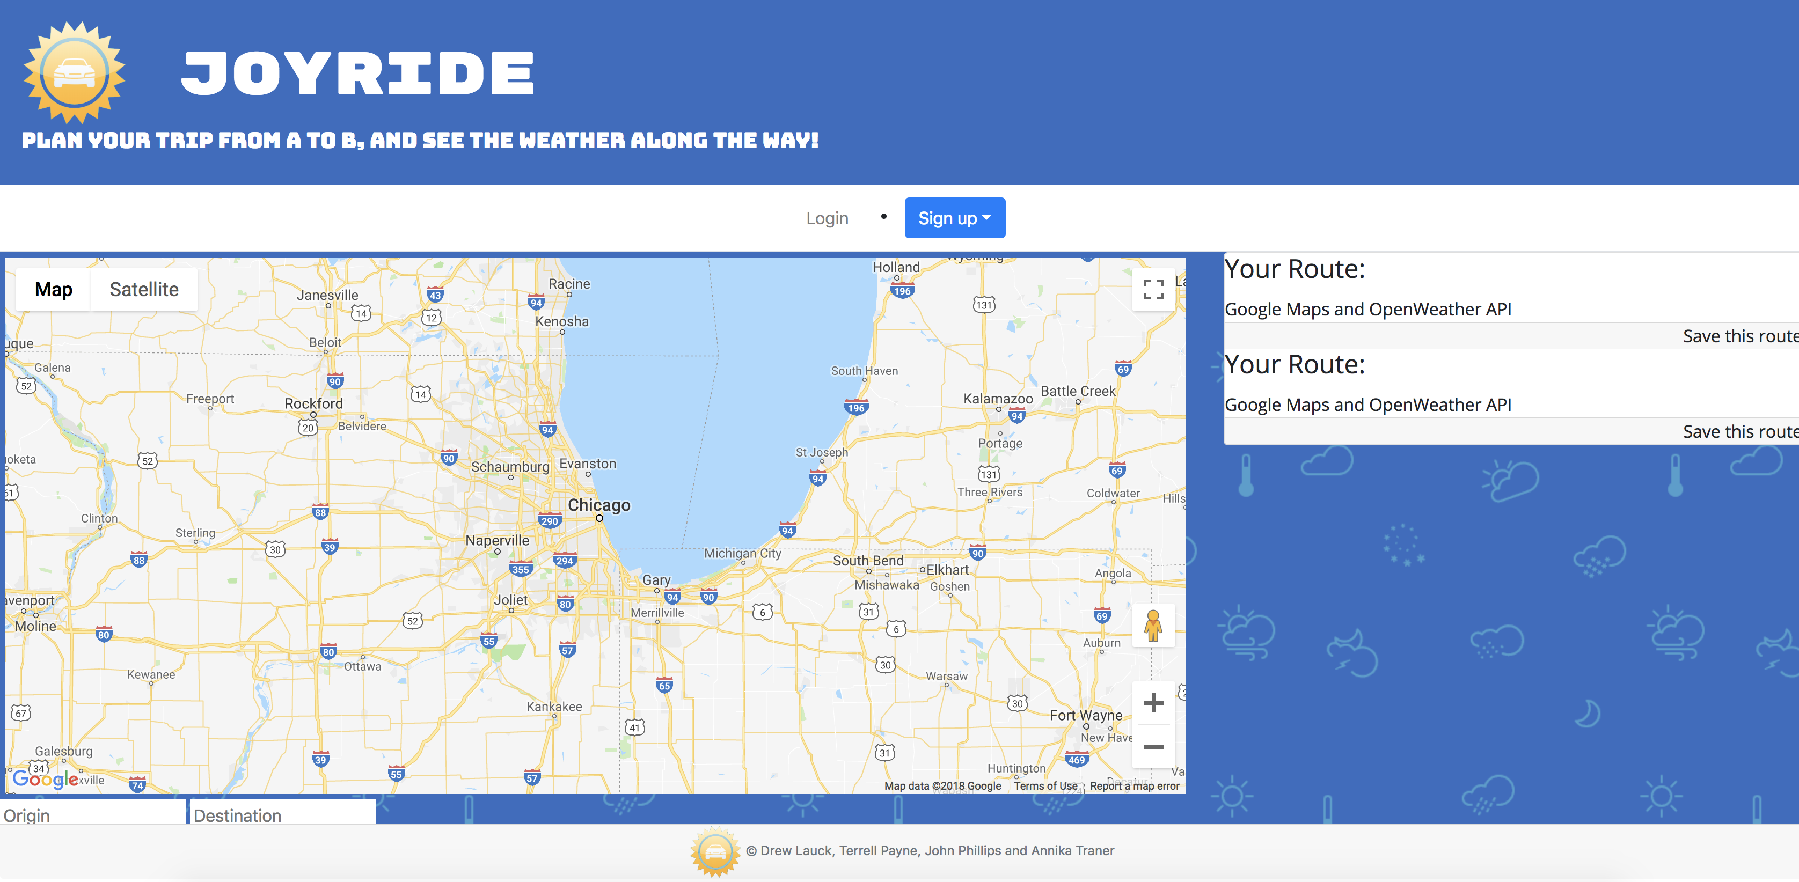

Slide 5
What exactly can joyride do?
joyride
Joyride works like your normal Google or Apple maps application.
By entering your desired destination, Joyride populates multiple routes to get you there from your current location, or another specified starting point, but also notifies you of brewing storms, rain, snow, etc. that you might encounter along the way.
This way, no one’s getting caught in the rain!

Slide 6
So how does it work?
joyride
Joyride pulls from two existing APIs:
Google Maps
&
OpenWeatherMap
Thereby presenting you with the safest, least hazardous route!

Slide 7
What else can it do?
joyride
Joyride also has a user login system, where you can link your social media accounts (Facebook or Twitter) to your recently searched trips.
Don’t use social media? That’s okay!
You can also create a username and password exclusively for the Joyride application, so you can save your trips to your account and access them from any device.

Slide 8

But really….
how does it actually work?

Slide 9
Getting into the code let’s go to GitHub!

Slide 10
Joyride
Any questions?

Slide 11
Joyride
Group #4 - Annika, Drew, John & Terrell

